Slide 1

The Final Delivery
Students. INC

Slide 2
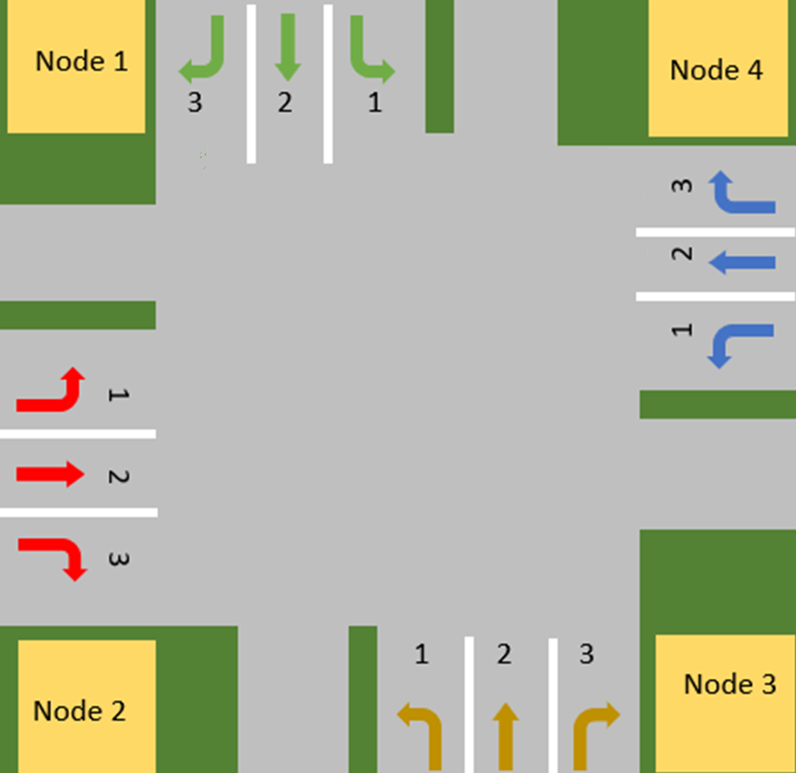
System overview
One central intersection
Designated Lanes
Sensors and control mechanisms

Slide 3
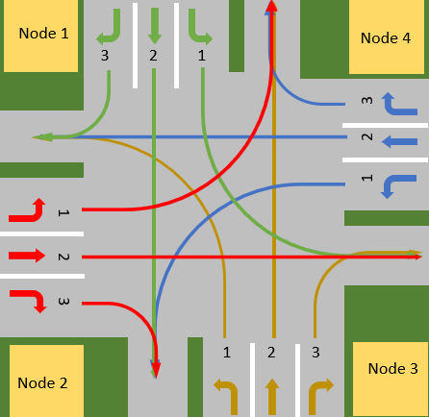
System behavior

Slide 4

System features
Priority system
Reliable wireless communication
Extensibility
Software and physical tests assurance
Green waves

Slide 5

Reflection
What went well ?
What could have gone better ?

Slide 6
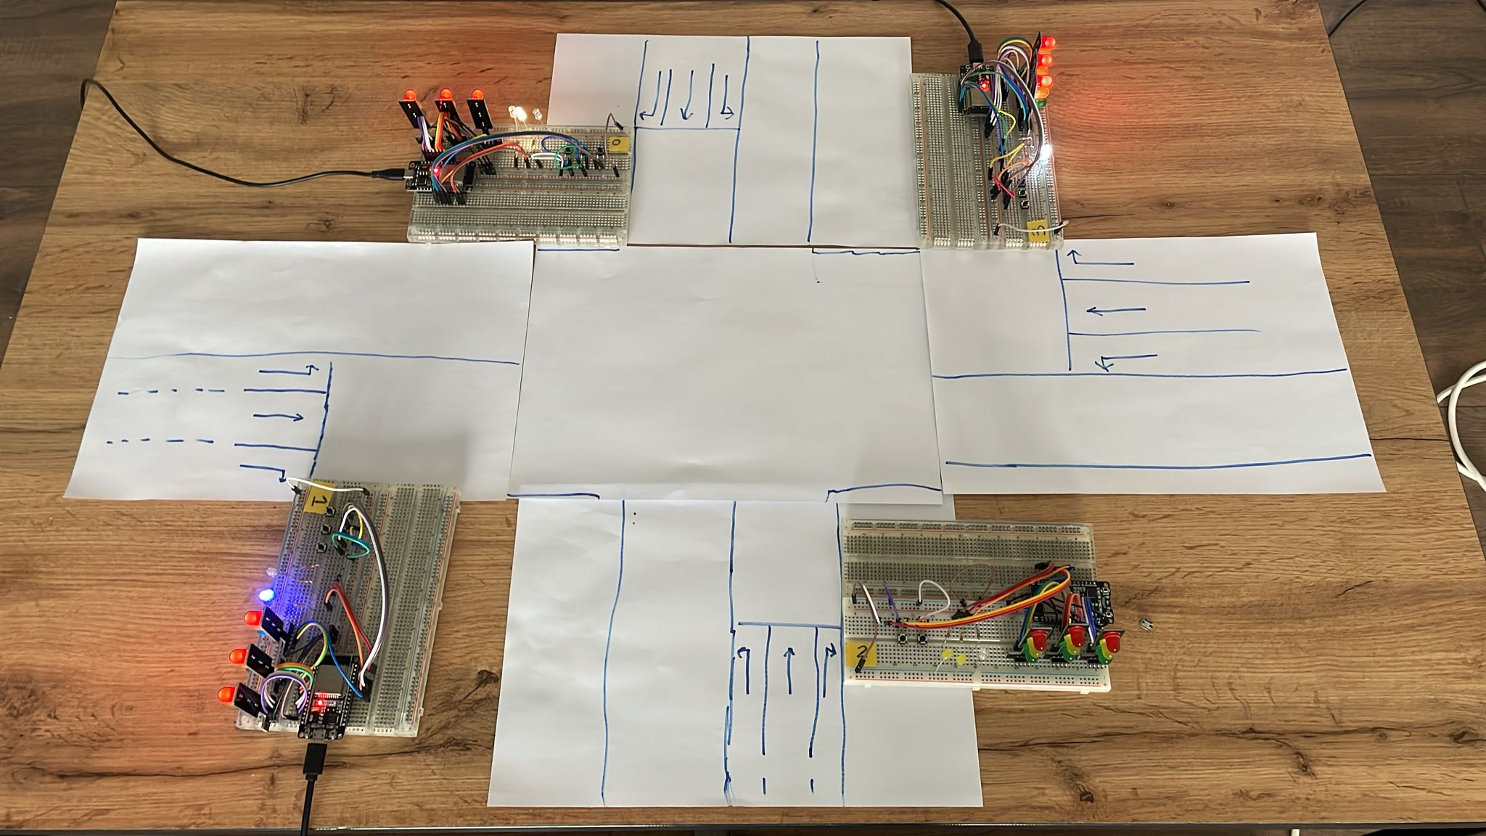
Demo

Slide 7
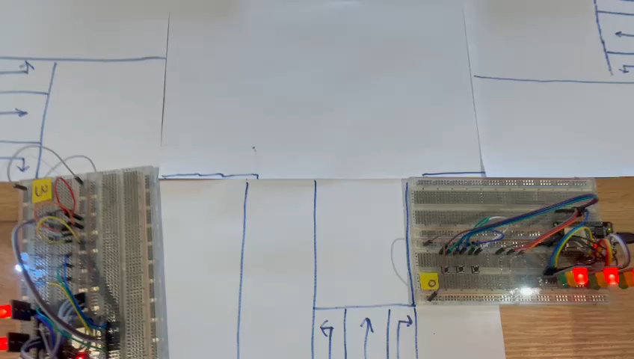
Scenario 1
Pre-conditions: different cars queue up on one direction
Expected outcome: The system acts accordingly by giving the vehicles way of right

Slide 8
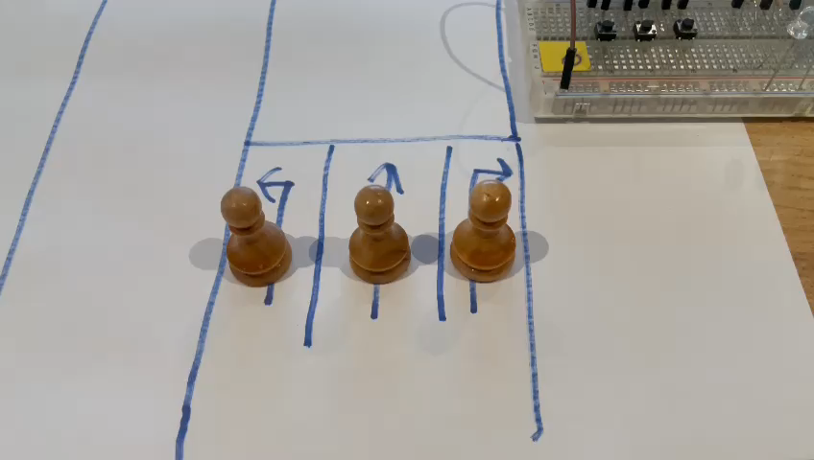
Scenario 2
Pre-conditions: Three cars queued up on one direction, one later on another direction
Expected outcome: flow of traffic is handled between the two directions, also when other vehicles arrive

Slide 9
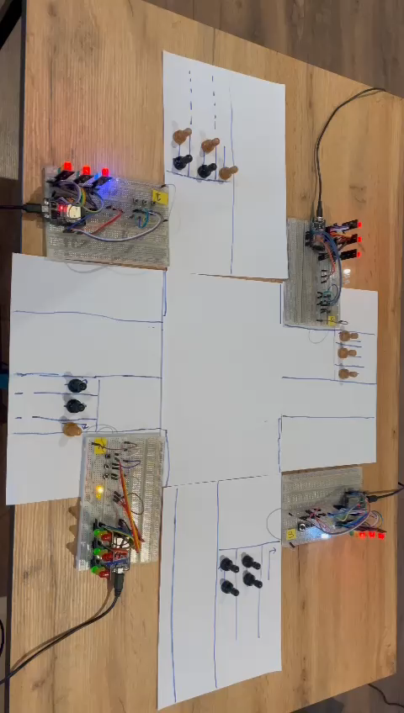
Scenario 3
Pre-conditions: Many cars queued up from all directions
Expected outcome: Flow of traffic is handled accordingly

Slide 11

Questions?

Slide 12

Thank you for your attention

